Slide 1
Big Data - Lecture 3
Storage - Relational vs. NoSQL

Slide 2
Relational Databases
For almost as long as we’ve been in the software profession, relational databases have been the default choice for serious data storage, especially in the world of enterprise applications.
Key Benefits
Persistence
the most obvious value of a database is keeping large amounts of persistent data
Concurrency
Relational databases help handle this by controlling all access to their data through transactions
Integration
A common way to do this is shared database integration where multiple applications store their data in a single database
Consistent model
developers and database professionals can learn the basic relational model and apply it in many projects.

Slide 3
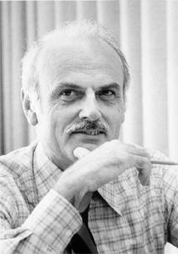
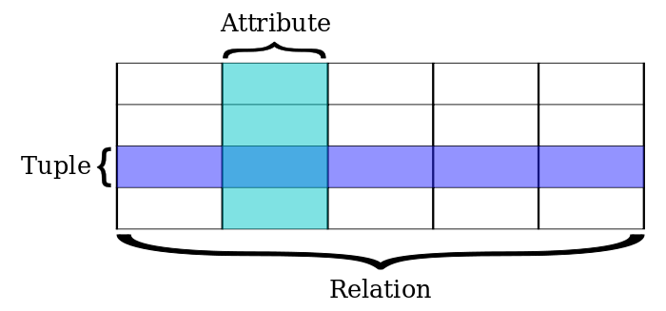
Codd invents a new model
Edgar Frank "Ted" Codd (August 19, 1923 – April 18, 2003) was an English computer scientist who, while working for IBM, invented the relational model for database management, the theoretical basis for relational databases
Initially, IBM refused to implement the relational model in order to preserve revenue from IMS/DB. Codd then showed IBM customers the potential of the implementation of its model, and they in turn pressured IBM.
Codd was the ‘rebel’ of his time.

Slide 4
Terminology
SQL term | Relational database term | Description
Row | Tuple or record | A data set representing a single item
Column | Attribute or field | A labeled element of a tuple, e.g. "Address" or "Date of birth"
Table | Relation or Base relvar | A set of tuples sharing the same attributes; a set of columns and rows
View or result set | Derived relvar | Any set of tuples; a data report from the RDBMS in response to a query

Slide 5
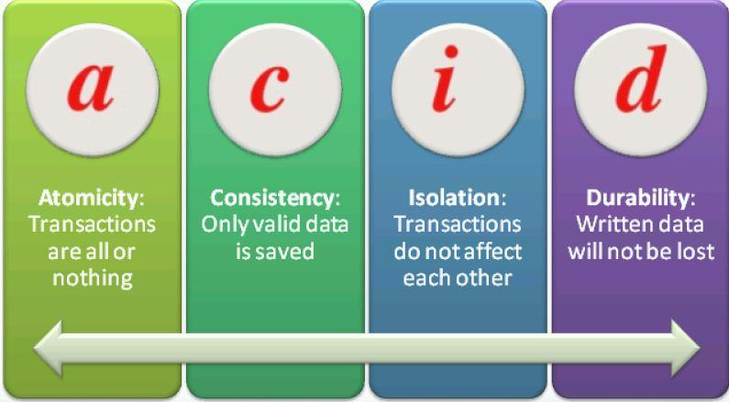
ACID

Slide 6
SQL
Originally based upon relational algebra and tuple relational calculus, SQL consists of a data definition language and a data manipulation language. The scope of SQL includes data insert, query, update and delete, schema creation and modification, and data access control.
SQL was initially developed at IBM by Donald D. Chamberlin, Donald C. Messerly, and Raymond F. Boyce in the early 1970s.^{[13]} This version, initially called SEQUEL (Structured English Query Language), was designed to manipulate and retrieve data stored in IBM's original quasi-relational database management system, System R
SELECT Book.title AS Title, COUNT(*) AS Authors FROM Book JOIN Book_author ON Book.isbn = Book_author.isbn GROUP BY Book.title;
output might resemble the following:
Title Authors ---------------------- ------- SQL Examples and Guide 4 The Joy of SQL 1 An Introduction to SQL 2 Pitfalls of SQL 1

Slide 7
Impedance Mismatch
...the difference between the relational model and the in-memory data structures.
The relational data model organizes data into a structure of tables and rows, or more properly, relations and tuples. In the relational model , a tuple is a set of name-value pairs and a relation is a set of tuples.
All operations in SQL consume and return relations, which leads to the mathematically elegant relational algebra.
This foundation on relations provides a certain elegance and simplicity, but it also introduces limitations. In particular, the values in a relational tuple have to be simple— they cannot contain any structure , such as a nested record or a list. This limitation isn’t true for in-memory data structures, which can take on much richer structures than relations. As a result, if you want to use a richer in-memory data structure, you have to translate it to a relational representation to store it on disk.

Slide 8
ORM Frameworks
Impedance mismatch has been made much easier to deal with by the wide availability of object-relational mapping frameworks, such as
Hibernate
iBATIS
that implement well-known mapping patterns, but the mapping problem is still an issue.
Object-relational mapping frameworks remove a lot of grunt work, but can become a problem of their own when people try too hard to ignore the database and query performance suffers.

Slide 9
Object Oriented Database?
The impedance mismatch is a major source of frustration to application developers, and in the 1990s many people believed that it would lead to relational databases being replaced with databases that replicate the in-memory data structures to disk.
That decade was marked with the growth of object-oriented programming languages, and with them came object-oriented databases— both looking to be the dominant environment for software development in the new millennium. However, while object-oriented languages succeeded in becoming the major force in programming, object -oriented databases faded into obscurity.

Slide 10
Databases for Integration
The exact reasons why relational databases triumphed over OO databases are still the subject of an occasional pub debate for developers of a certain age.
The primary factor was the role of SQL as an integration mechanism between applications. In this scenario, the database acts as an integration database—with multiple applications, usually developed by separate teams, storing their data in a common database. This improves communication because all the applications are operating on a consistent set of persistent data.

Slide 11
Web Services
During the 2000s we saw a distinct shift to web services, where applications would communicate over HTTP. Web services enabled a new form of a widely used communication mechanism— a challenger to using the SQL with shared databases (Service Oriented Architecture - SOA - now called MicroServices).
This allowed databases to be isolated to services and took the focus of the database as the primary form of integration.
Since there is a decoupling between your internal database and the services with which you talk to the outside world, the outside world doesn’t have to care how you store your data, allowing you to consider non-relational options.
Furthermore, there are many features of relational databases, such as security, that are less useful to an application database because they can be done by the enclosing application instead.

Slide 12
Normalization
Database normalization is the process of organizing the fields and tables of a relational database to minimize redundancy and dependency. Normalization usually involves dividing large tables into smaller (and less redundant) tables and defining relationships between them. The objective is to isolate data so that additions, deletions, and modifications of a field can be made in just one table and then propagated through the rest of the database using the defined relationships.
Normal Forms? How to start conversation at (geek) cocktail parties...

Slide 13
1NF
First Normal Form (1NF): No repeating elements or groups of elements
Don't repeat your columns. Avoid this: ItemId1, 2, ... should be split out into relational tables.
OrderId | ItemId1 | ItemId2 | …
1 | 100 | 101

Slide 14
2NF
Second Normal Form (2NF): No partial dependencies on a concatenated key
This is a complex way of saying that if a column isn’t intrinsically related to the entire primary key, then you should break out the primary key into different tables.
Example:
The primary key is (OrderId, ItemId).
Consider OrderDate. It is conceptually part of an order. An order always occurs at some time. But is an OrderDate related to an Item? Not really.
You may be saying, “but items are part of an order!”, and you would be right. But that’s not what we’re getting at. OrderDate is independent of the item itself.
Look at another way: in the table the OrderDate will always be the same for a given OrderId regardless of the value of the ItemId column. This means data duplication, which is denormalization.
OrderId (PK) | ItemId (PK) | OrderDate | …
1 | 100 | 2009-01-01
1 | 101 | 2009-01-01

Slide 15
3NF
Third Normal Form (3NF): No dependencies on non-key attributes
2NF covers the case of multi-column primary keys. 3NF is meant to cover single column keys. Simply stated, pull out columns that don’t directly relate to the subject of the row (the primary key), and put them in their own table.
Example:
Customer information could be the subject of its own table. Pull out customer name and other customer fields into another table, and then put a Customer foreign key into Orders.
OrderId (PK) | OrderDate | CustomerName | CustomerCity
1 | 2009-01-01 | John Smith | Chicago

Slide 16
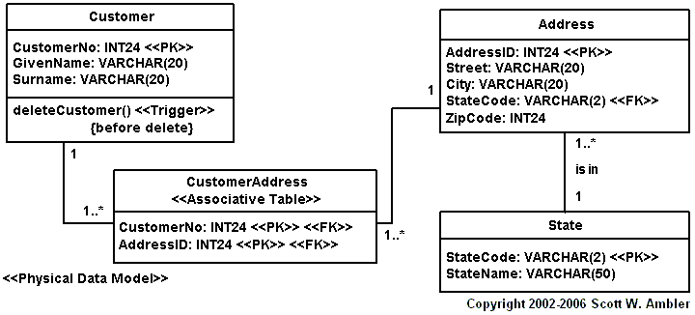
Example Relational Model

Slide 17
Data at a new scale
The 2000s saw several large web properties dramatically increase in scale.
This increase in scale was happening along many dimensions. Websites started tracking activity and structure in a very detailed way. Large sets of data appeared : links, social networks, activity in logs, mapping data. With this growth in data came a growth in users— as the biggest websites grew to be vast estates regularly serving huge numbers of visitors.
Coping with the increase in data and traffic required more computing resources. To handle this kind of increase, you have two choices: up or out. Scaling up implies bigger machines, more processors, disk storage, and memory. But bigger machines get more and more expensive , not to mention that there are real limits as your size increases.

Slide 18
Clusters
The alternative is to use lots of small machines in a cluster. A cluster of small machines can use commodity hardware and ends up being cheaper at these kinds of scales. It can also be more resilient— while individual machine failures are common, the overall cluster can be built to keep going despite such failures, providing high reliability.
Relational databases were not designed to be run on clusters. Clustered relational databases, such as the Oracle RAC or Microsoft SQL Server, work on the concept of a shared disk subsystem.
Relational databases could also be run as separate servers for different sets of data, effectively sharding the database. While this separates the load, all the sharding has to be controlled by the application which has to keep track of which database server to talk to for each bit of data. Also, we lose any querying, referential integrity , transactions , or consistency controls that cross shards.
These technical issues are exacerbated by licensing costs. Commercial relational databases are usually priced on a single-server assumption, so running on a cluster raised prices and led to frustrating negotiations with purchasing departments.

Slide 19
The Emergence of NoSQL
The usage of “NoSQL” that we recognize today traces back to a meetup on June 11, 2009 in San Francisco organized by Johan Oskarsson, a software developer based in London.
The example of BigTable and Dynamo had inspired a bunch of projects experimenting with alternative data storage, and discussions of these had become a feature of the better software conferences around that time.
Johan wanted a name for the meetup— something that would make a good Twitter hashtag: short, memorable, and without too many Google hits so that a search on the name would quickly find the meetup.
#NoSQL

Slide 20
Attributes of NoSQL DBs
Don’t use SQL/Relational Model (although some resemble it - C* CQL)
Open source projects
Run well on clusters
Tunable Consistency
Flexible Schemas
Resilience to failure
Handle massive read/write loads
Self healing

Slide 21
CAP Theorem
the CAP theorem, also known as Brewer's theorem, states that it is impossible for a distributed computer system to simultaneously provide all three of the following guarantees:
Consistency (all nodes see the same data at the same time)
Availability (a guarantee that every request receives a response about whether it was successful or failed)
Partition tolerance (the system continues to operate despite arbitrary message loss or failure of part of the system)

Slide 22
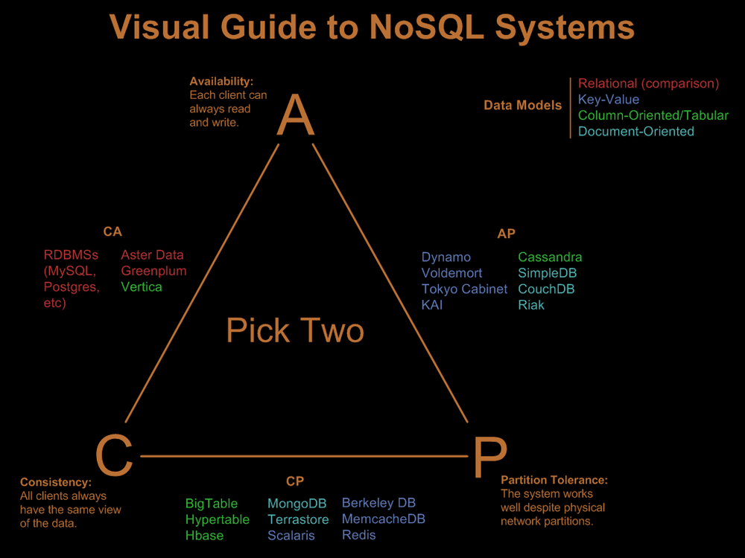
CAP Theorem Visualized

Slide 23
Polyglot Persistence
“At GNIP we used NoSQL to make money and MySQL to count it.”
Most organizations are start to have both relational and NoSQL stores.
Questions to ask?
Is my data transactional? (e.g. Bank records)
Is eventual consistency OK?
Does my data volume size exceed existing relational systems? (e.g. 200M rows)
Are my read / write volumes greater than existing relational systems can handle?
Do I know questions I want to ask of my data upfront?
Is my data, really just factual data? (e.g. tweets, fitbit, etc.)

Slide 24
Google & Amazon
Read these…
Google Big Table
http://research.google.com/archive/bigtable.html
Amazon Dynamo
http://www.allthingsdistributed.com/2007/10/amazons_dynamo.html

